Slide 1
The Website of MIS at the MOE

Slide 2
An integrated educational management information system contributes to the formulation and policy guidance through the availability of accurate comprehensive and timely information for rational decision-making and for the support of equalization of quantitative and qualitative learning opportunities by Investing available Human, financial and material resources.

Slide 3
How to get to our website
At the address bar of any internet explorer type the URL of the Ministry of Education: www.moe.gov.jo
From the the main page select the School Map
(نظام المعلومات)

Slide 4
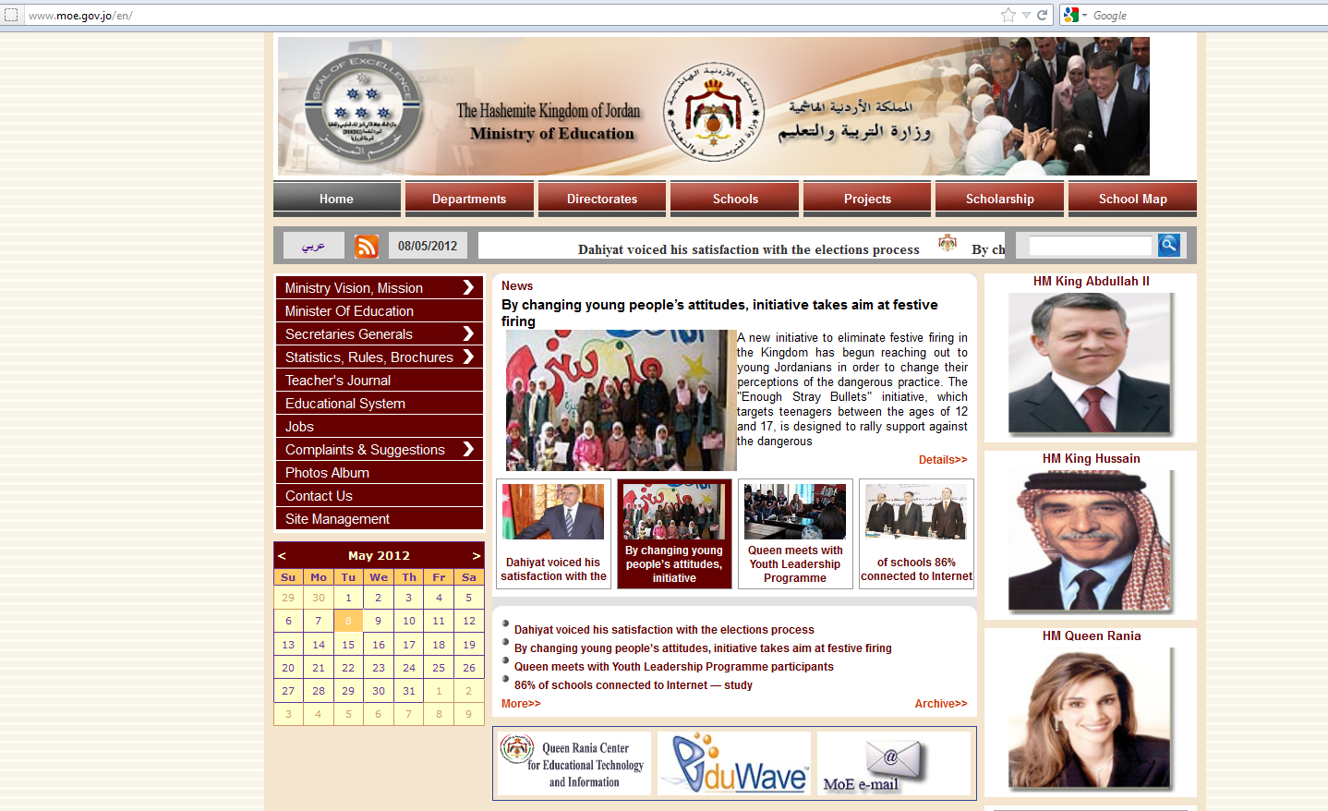
Click on the focused link

Slide 5
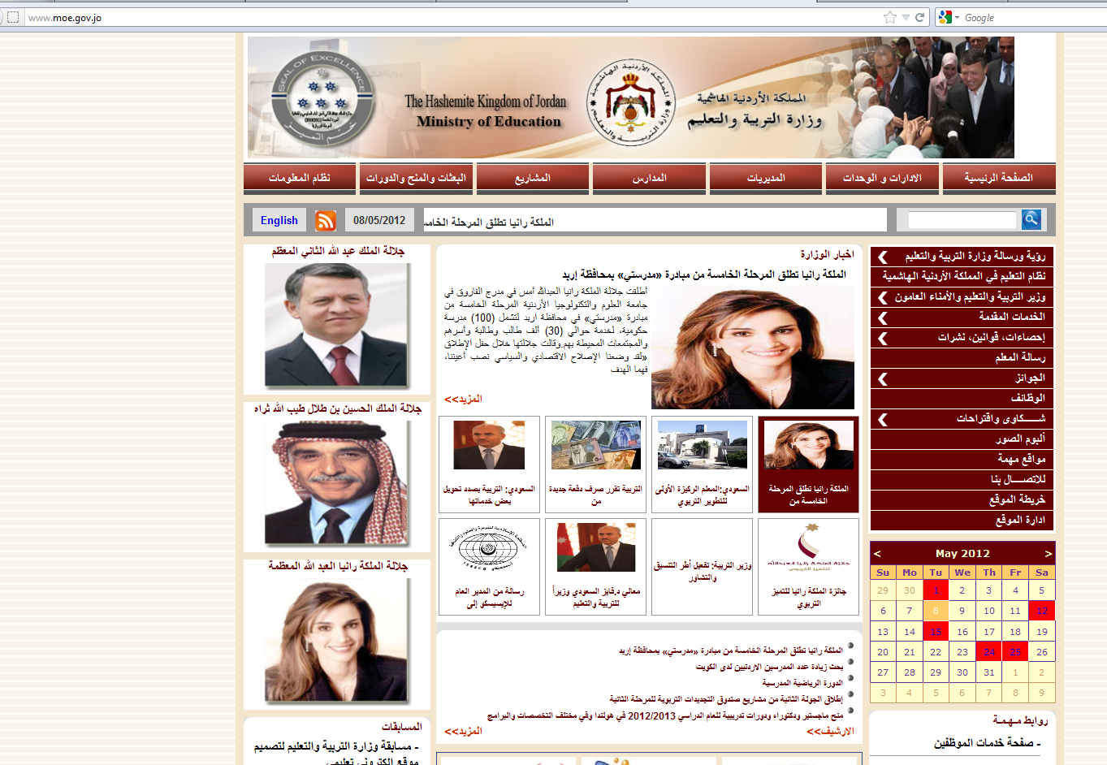
Click on the focused link

Slide 6
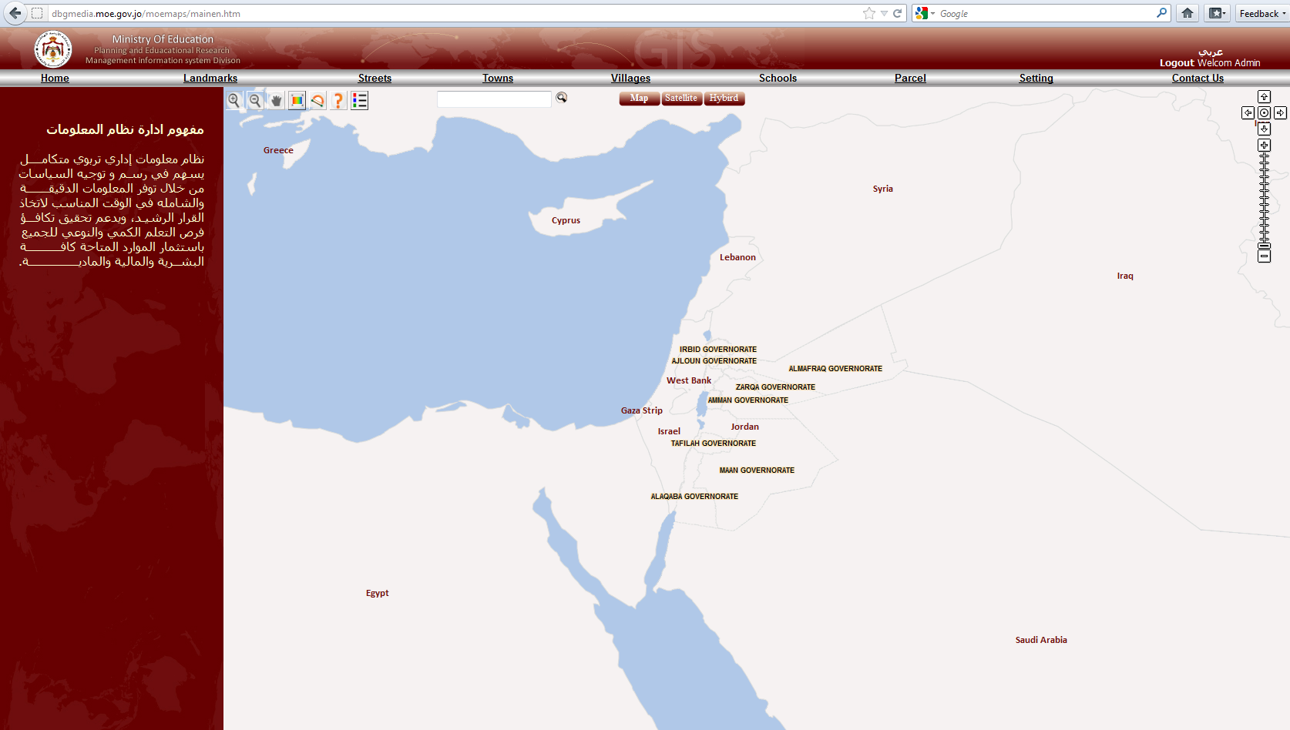
This main page will appear, which represent the Graphical Information system of our Department

Slide 7
This is the toolbar that you can choose any according to the information you seek for
6
5
4
3
2
1
Setting differ according to user type
These three keys to select type of view
zoom in zoom out either by click ing or draw rectangle
This is the key toolbar , you can do view through it many thing
1
Choose what to view School, Regions ,Directorates or all.
Search bar
2
Show name of any point
3
Calculate the distance between any 2 points (start and end)
4
Choose the fit size
Click and drag to get to needed position
5

Slide 9
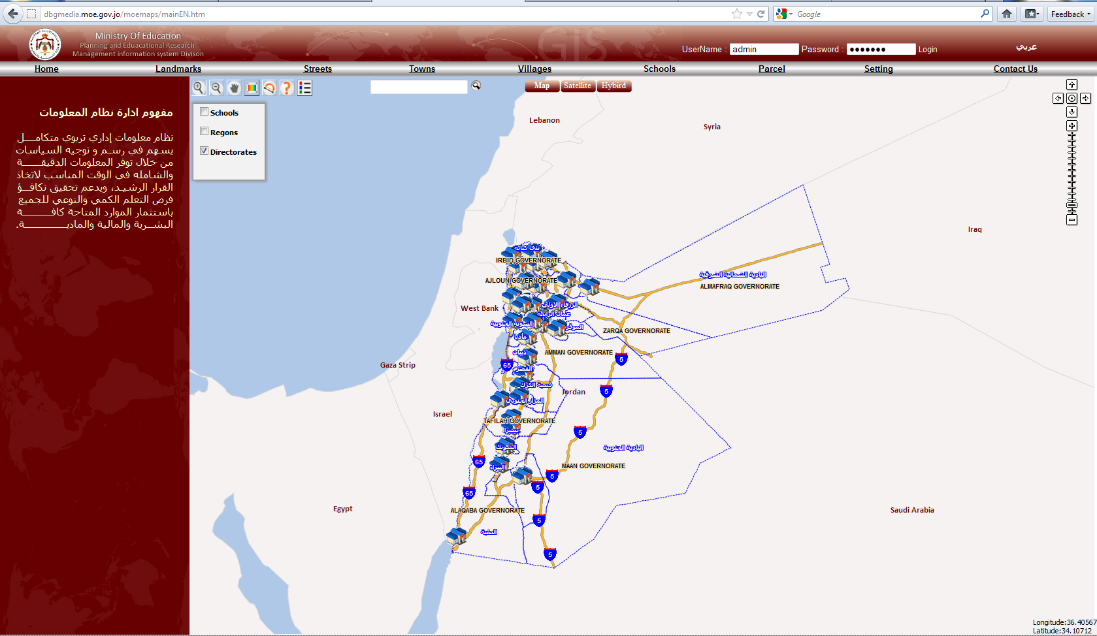
These three keys to view position and names

Slide 10
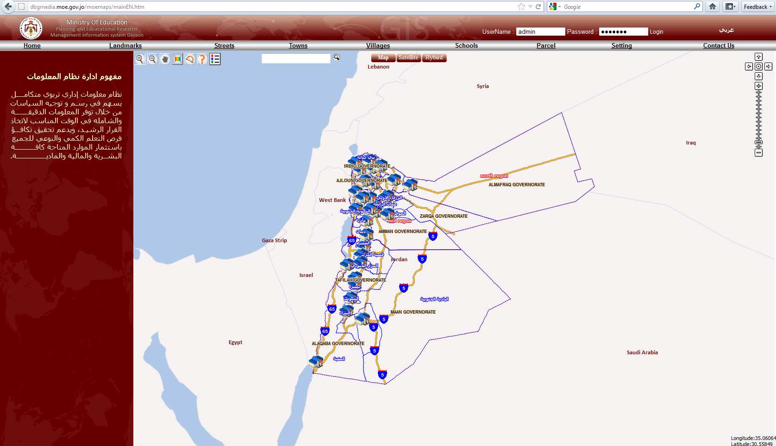

Slide 11
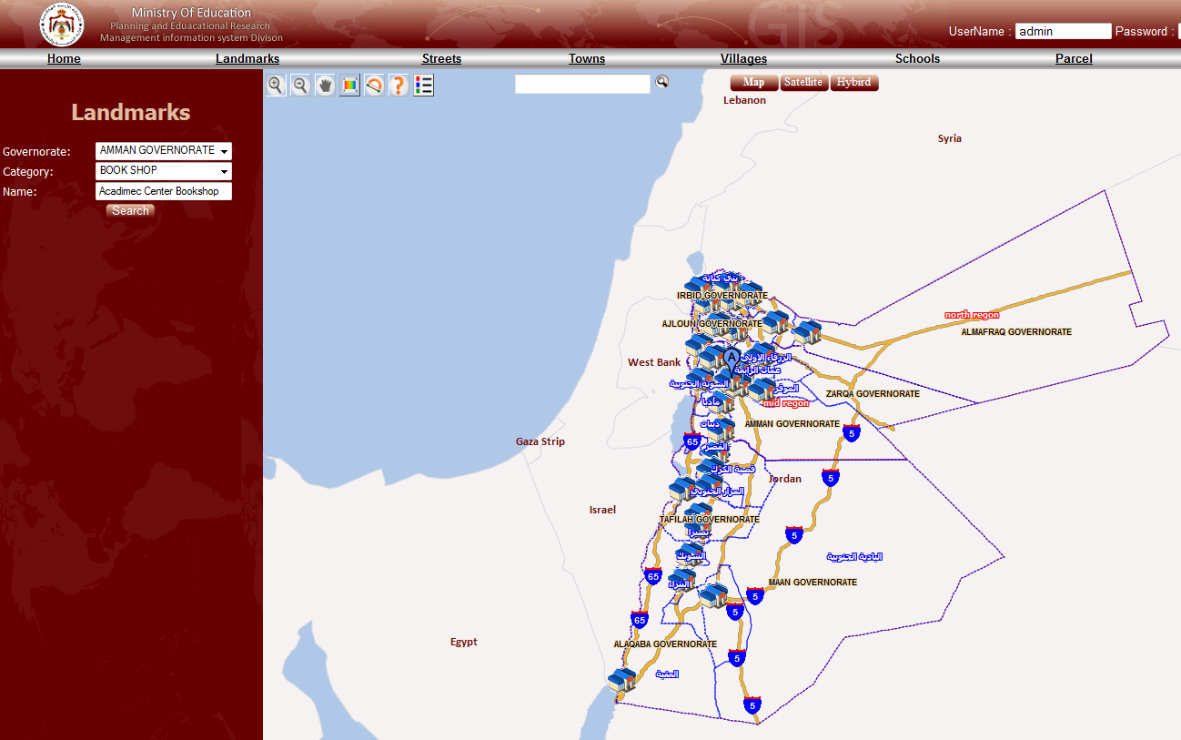
You can search for any Landmarks through these information to specify by Governorate and category and also by name (if leave it blank its ok but will get more results)

Slide 12
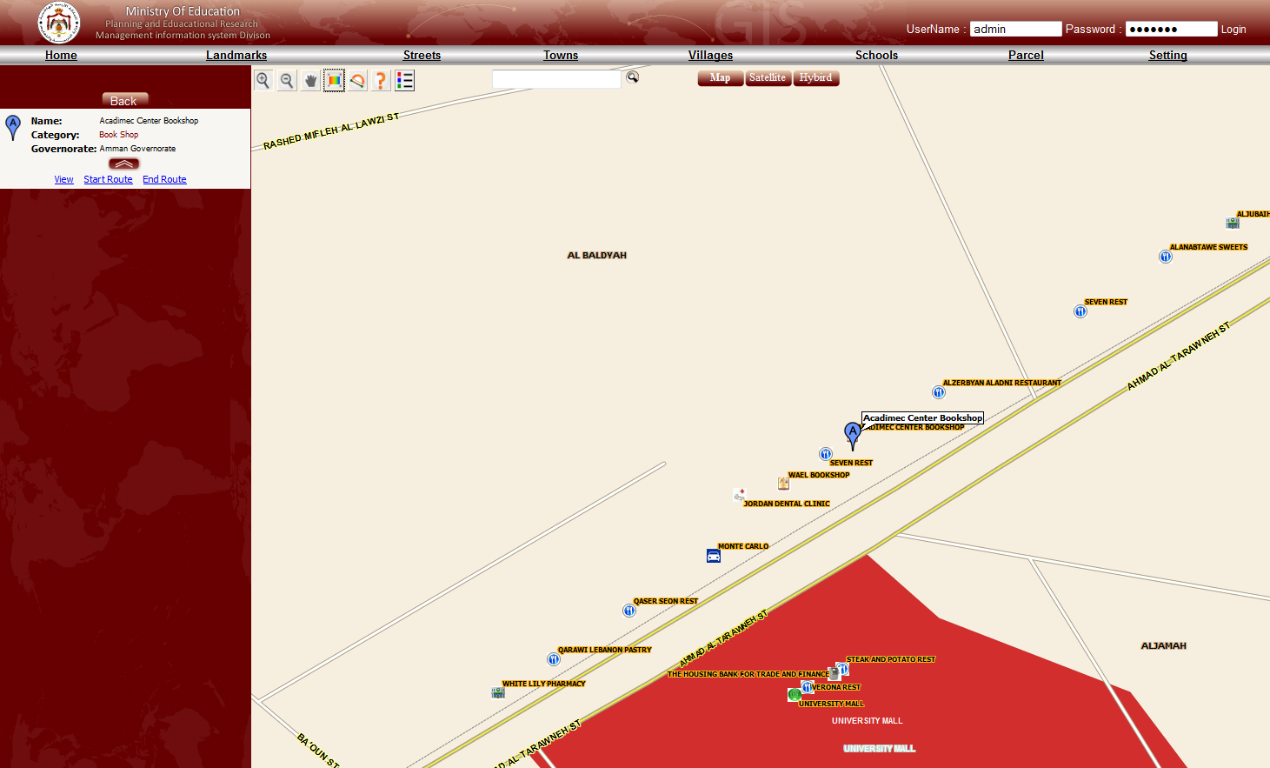
The result will be as shown, beside that you can get the shortest way to get there

Slide 13
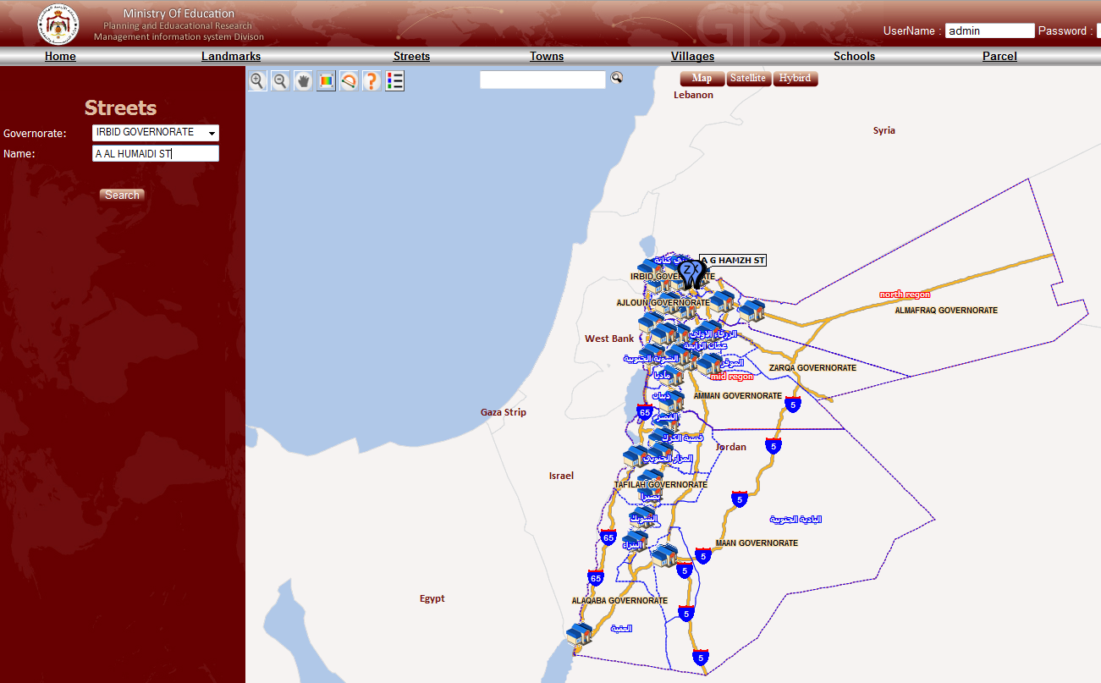
You can search for any Street through specify above information and also by name (if leave it blank its ok but will get more results)

Slide 14
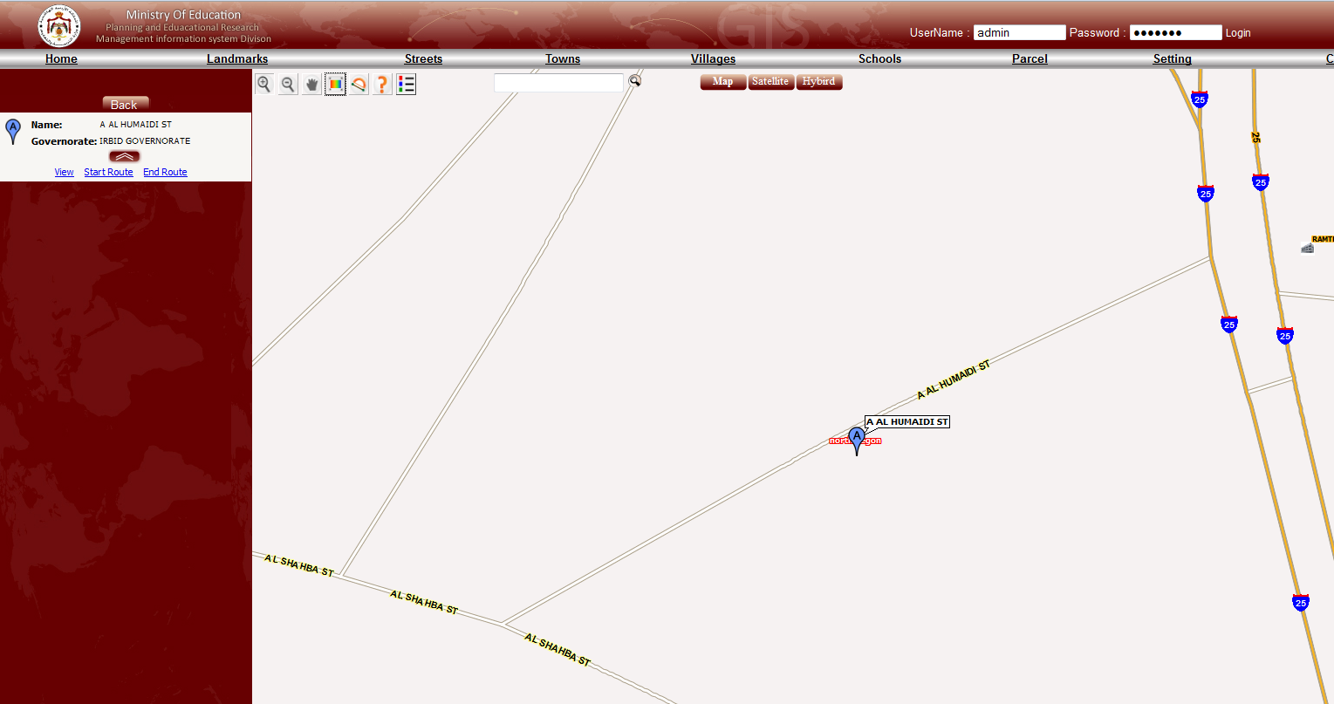
This the result you get clicking search then view

Slide 15
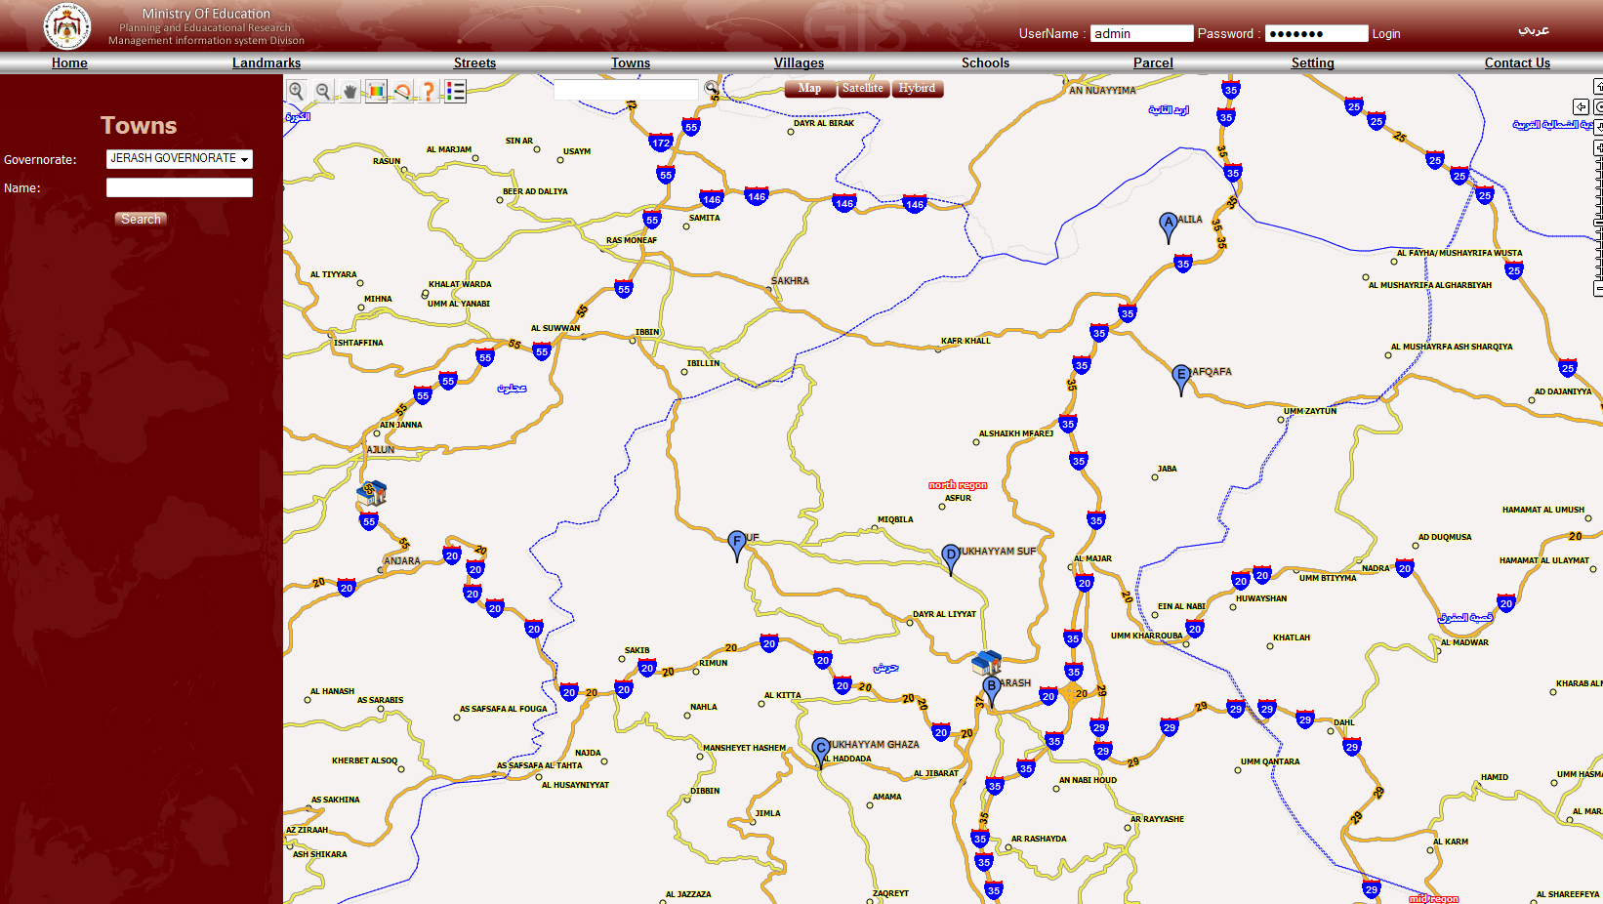
You can search for any Town through specify above information and also by name (if leave it blank its ok but will get more results)

Slide 16
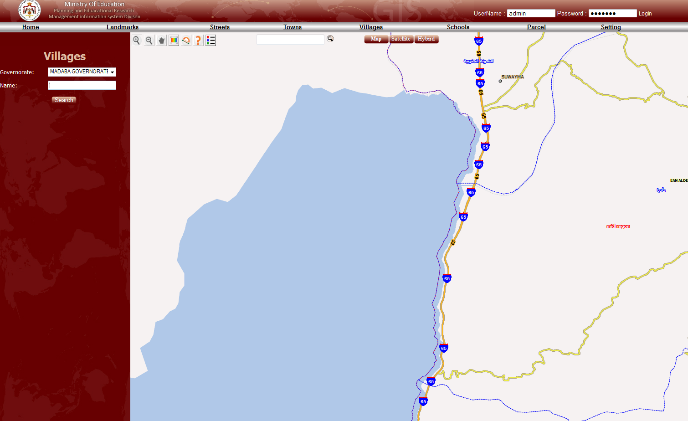
You can search for any Villages through specify above information and also by name (if leave it blank its ok but will get more results)

Slide 17
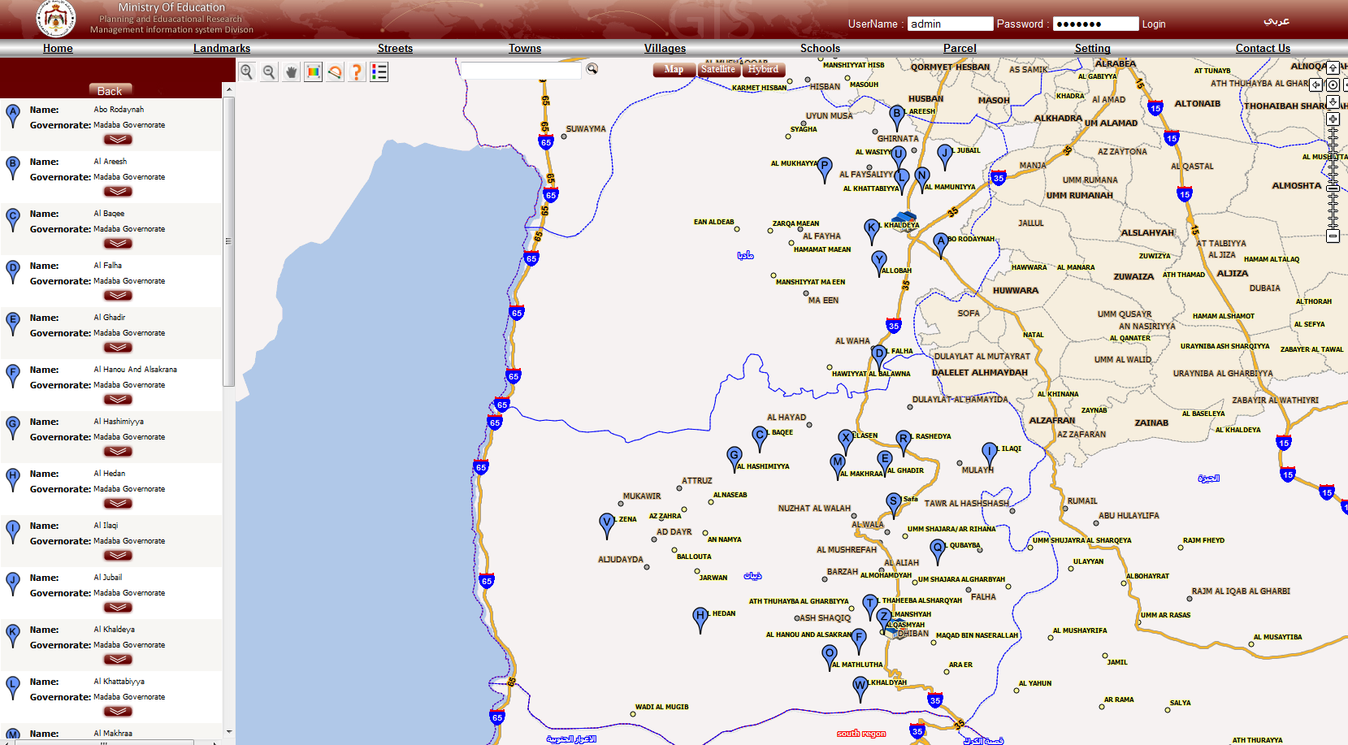
If not mentioned the name you will get many results to choose from

Slide 18
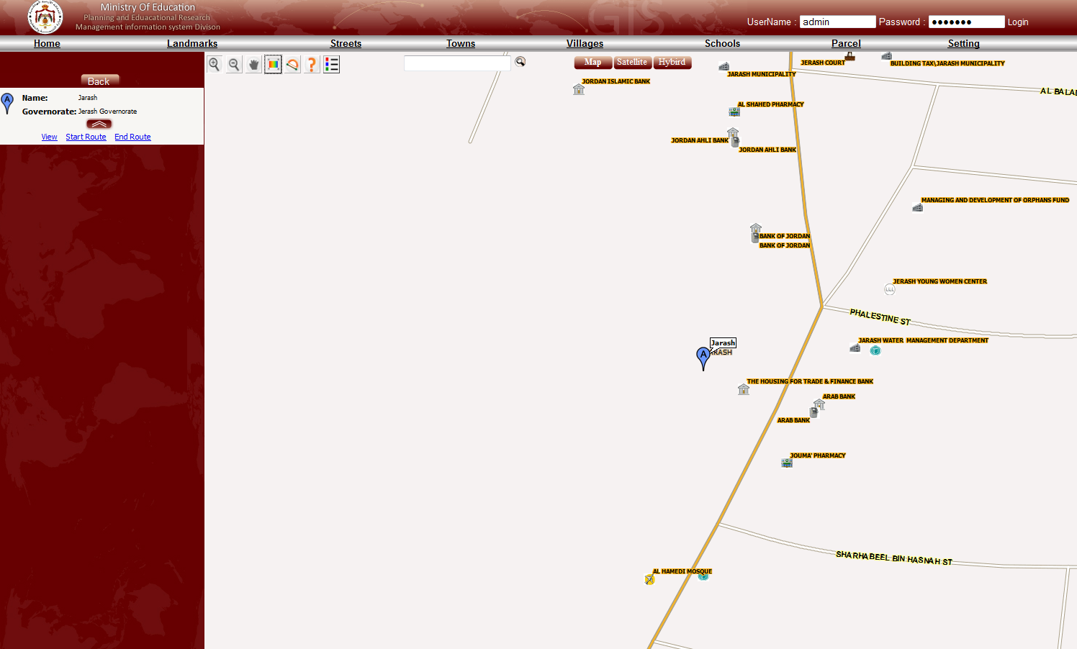
More detailed specify faster result and more accurate

Slide 19
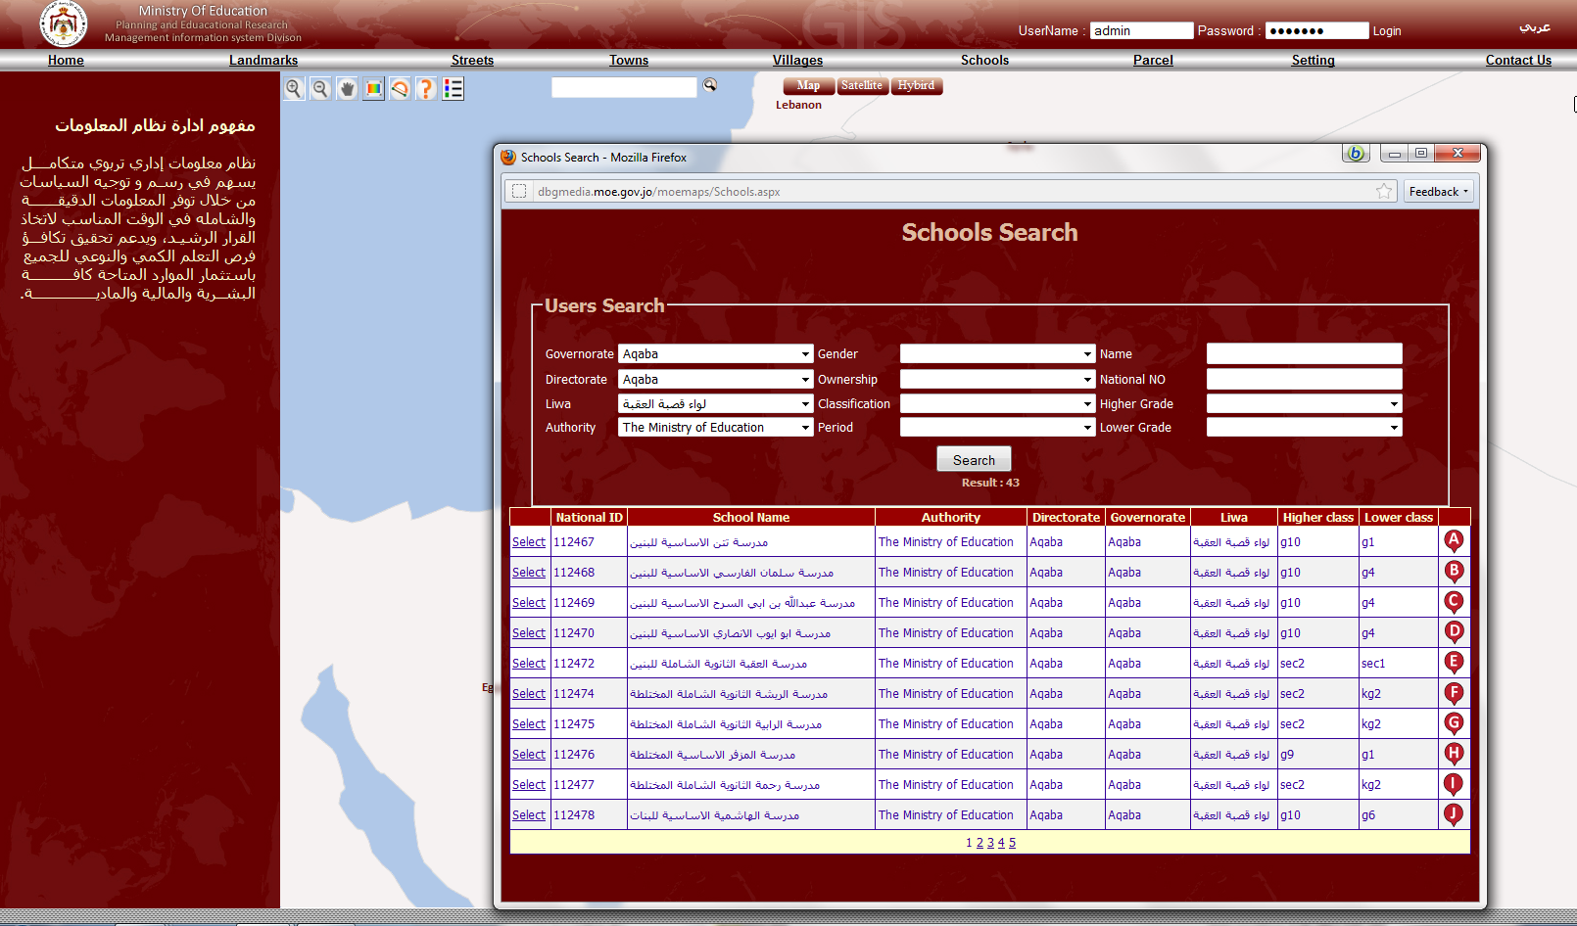
You can search for any school by specifying these information more details you specify, more accurate result you will get (if leave them blank ok but will get more results)

Slide 20
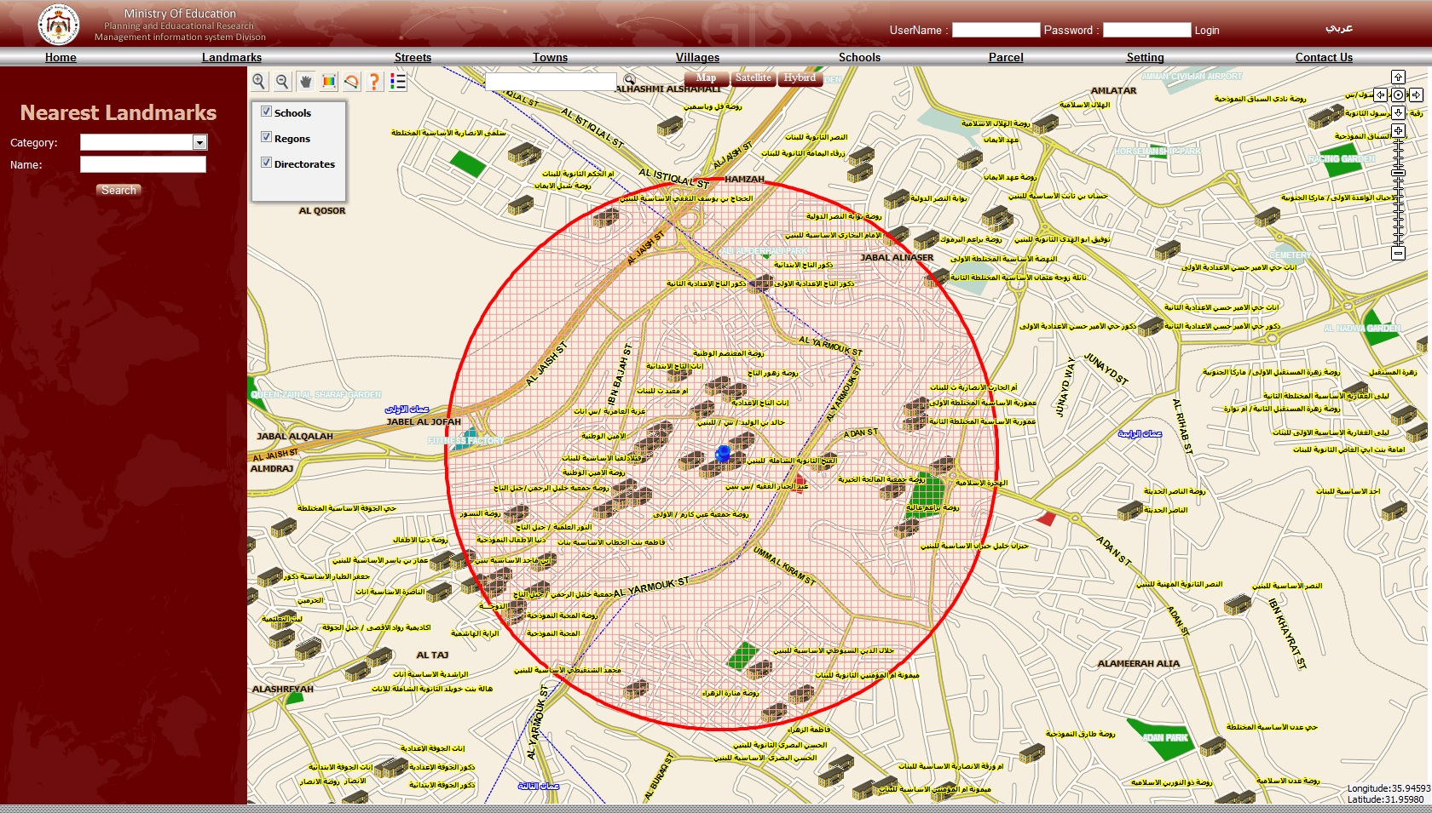
USING BUFFER according to a limited distance

Slide 21
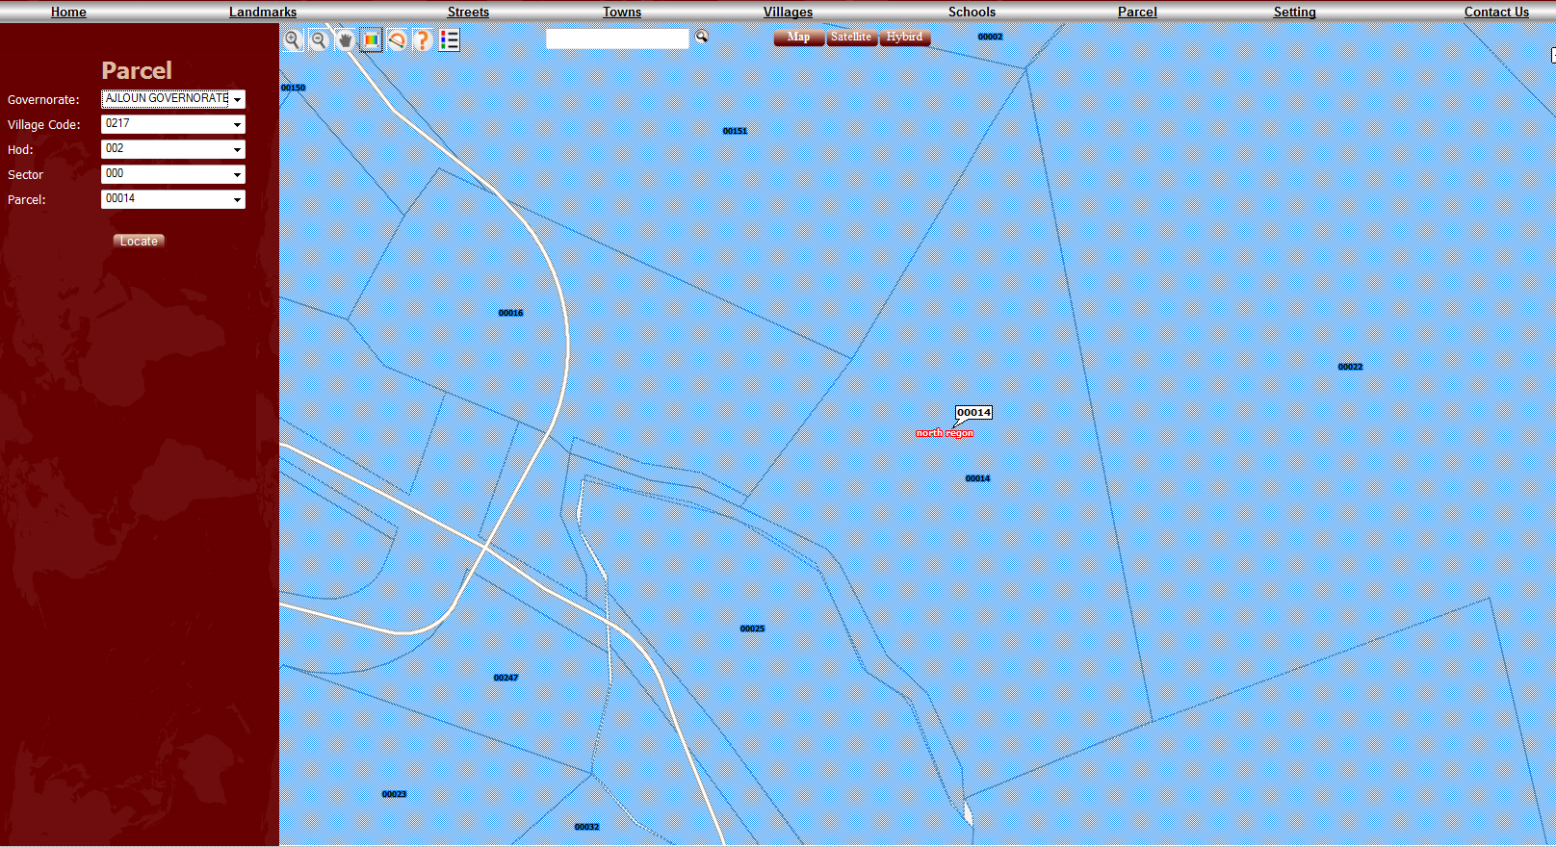
You can search for any Parcel through specify above information

Slide 22
2
1
These setting differ according to user privileges (Admin, DManager ,School manager,…)

Slide 23
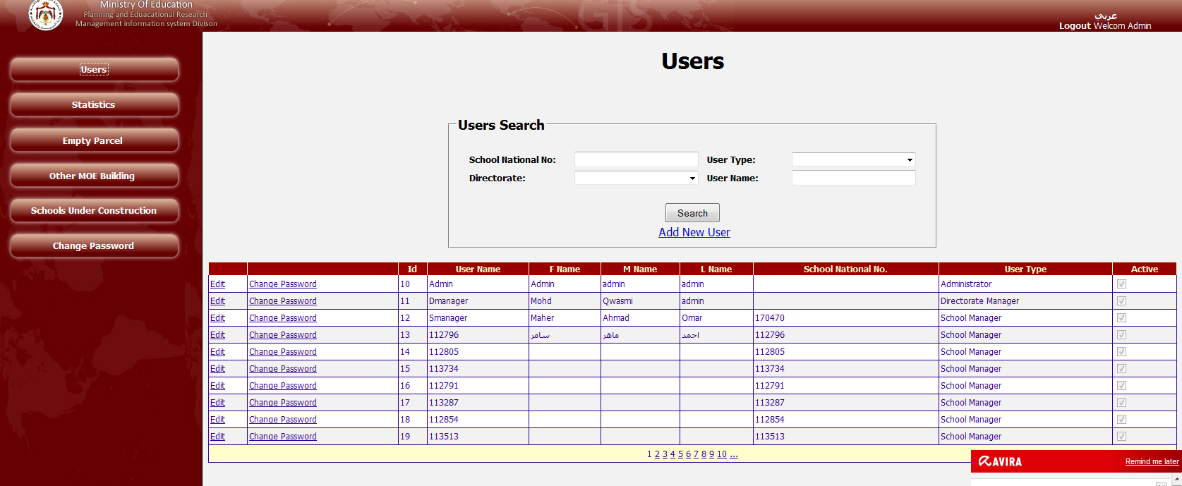
You can search for any user (should be an admin) and edit its info

Slide 24
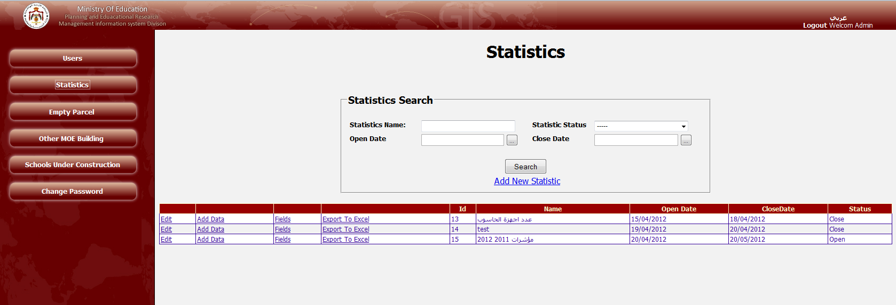
These setting differ according to user privileges (Admin, Manager ,…)
Otherwise you can create a new one from Add New
You can search for any previous created statistics or look for it from the list below and modify it

Slide 25
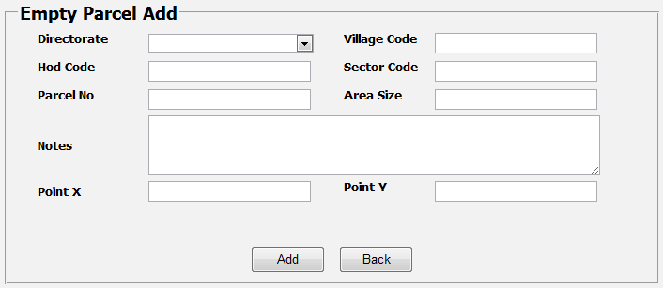
You can search for any previous created Empty Parcel or look for it from the list below and modify it
These setting differ according to user privileges (Admin, Manager ,…)
Otherwise you can create a new one from Add New and you will get form below to fill

Slide 26
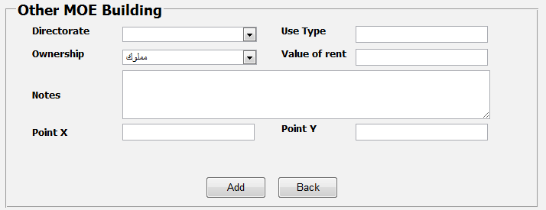
You can search for any previous created MOE building or look for it from the list below and modify it
These setting differ according to user privileges (Admin, Manager ,…)
Otherwise you can create a new one from Add New and you will get form below to fill

Slide 27
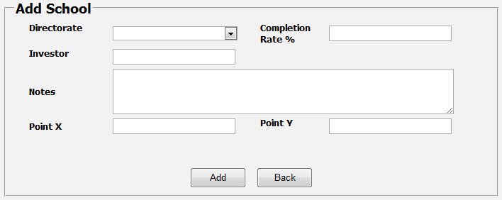
You can search for any previous created Schools under construction or look for it from the list below and modify it
These setting differ according to user privileges (Admin, Manager ,…)
Otherwise you can create a new one from Add New and you will get form below to fill

Slide 28
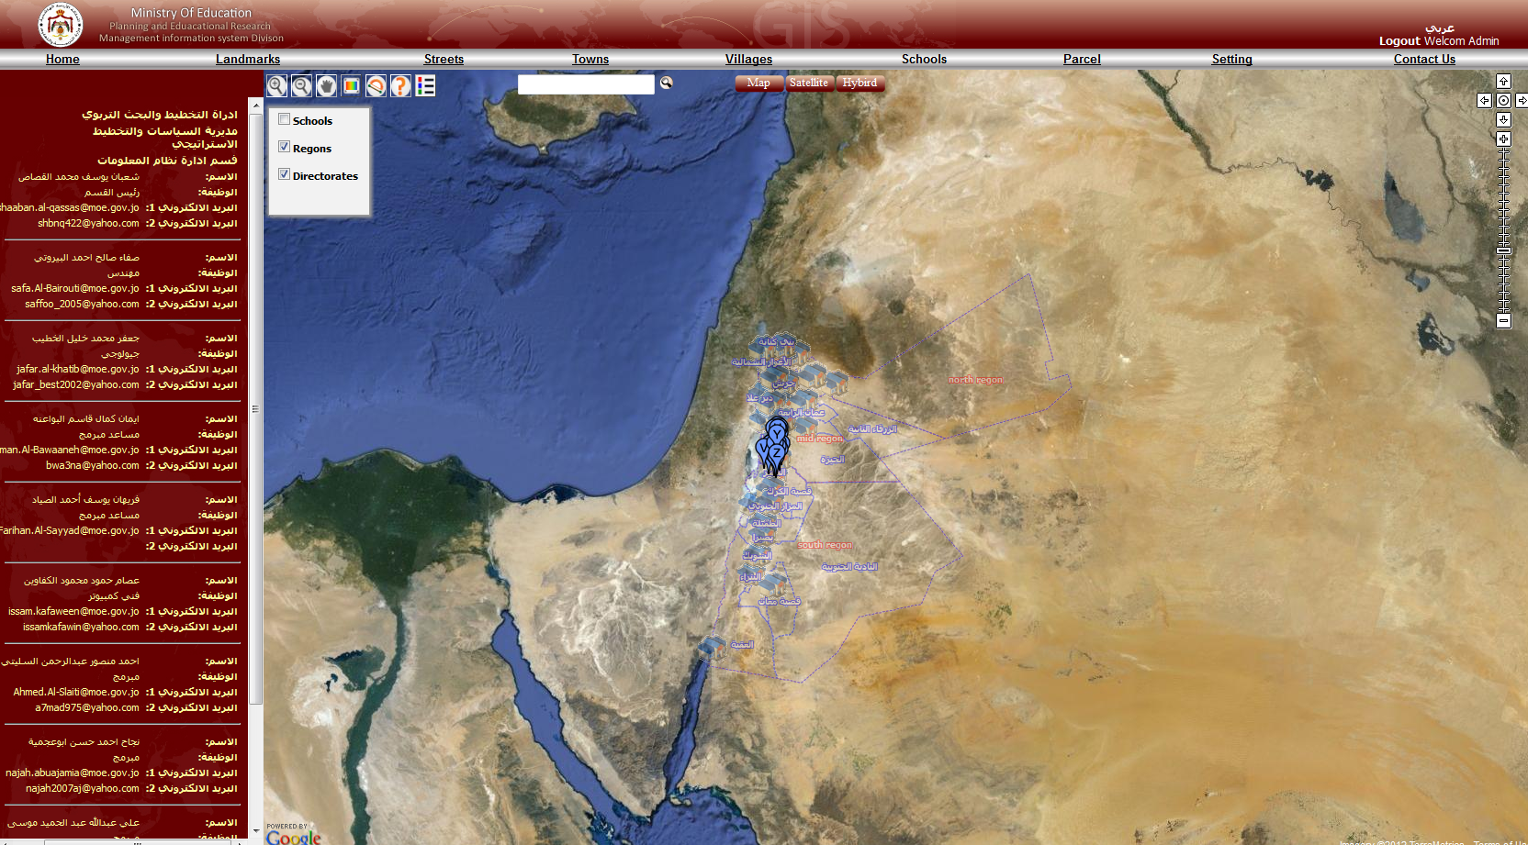

Slide 29
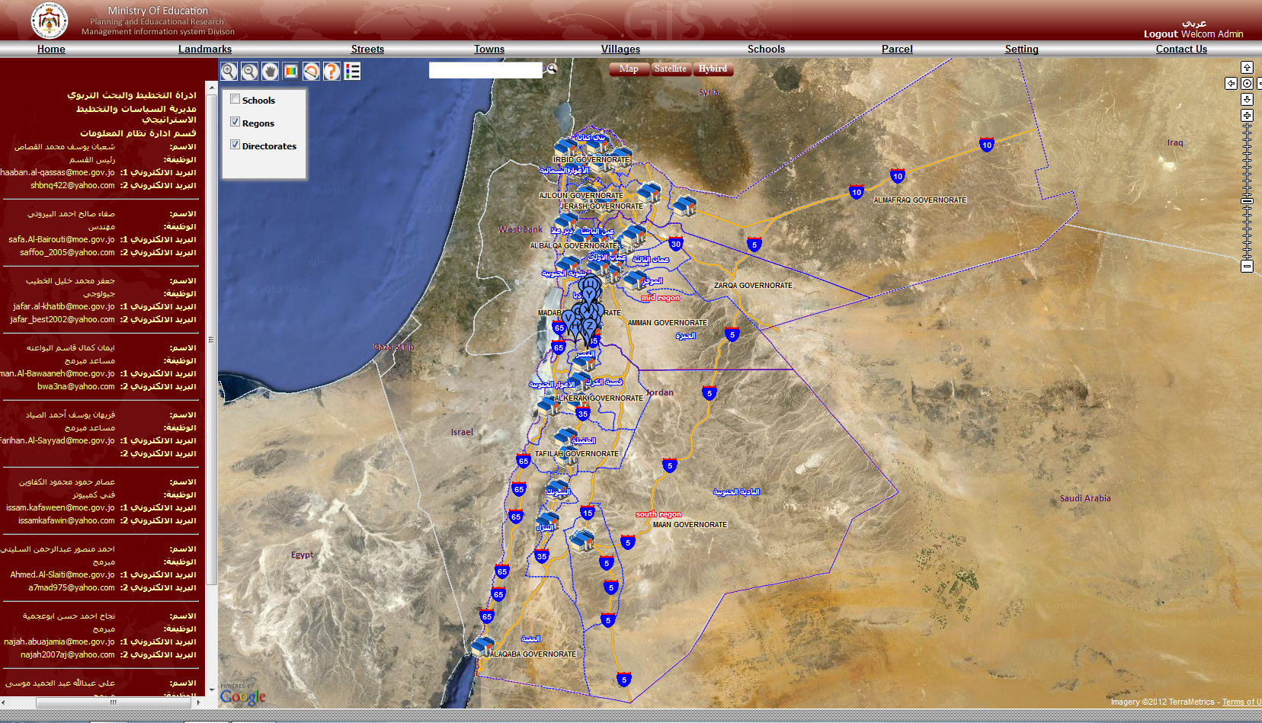
To contact any of the MIS employees click the contact and it will apear on the left side

